Slide 1
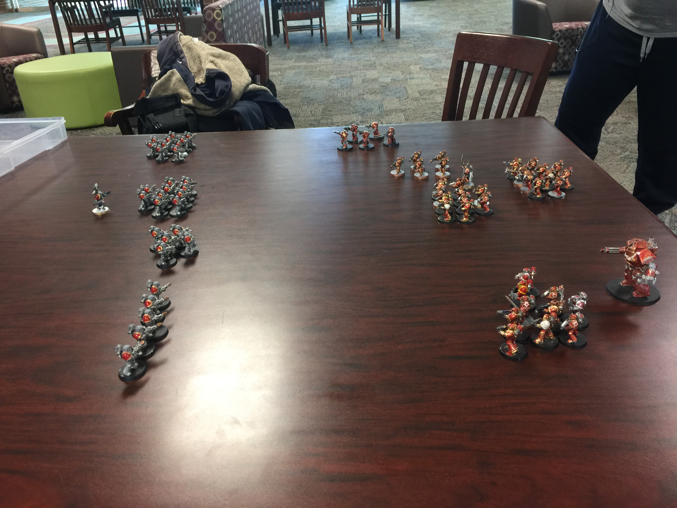
Warhammer 40K
Ian Nevills
James Laubach
Nicholas Reid

Slide 2
Background
This project is intended as an army builder program for the Warhammer 40k Table-top game and set up to work with the “Warhammer 40k: 7th Edition Armies in the Age of Darkness” rule book.
The Warhammer 40k table-top is a difficult game with myriad complex rules, it can take hours for a beginner to get through the army selection alone.
This program is intended to streamline the army selection process and allow beginners to get into the game faster.

Slide 3
Approach
For this project select information from the “Armies in the Age of Darkness” book was transcribed into an Access database and a unique eight digit number was assigned to each unit. Buttons on the UI for each unit send that ID number in the form of a string to a function that reads the database, which reads the information into an array, which is then used by a unit manager class and its functions to store and manipulate a list of the user's selections.
We used the libraries associated with using and accessing access databases.
The program's unit class and sub classes are based on an abstract factory and decorator pattern.

Slide 4
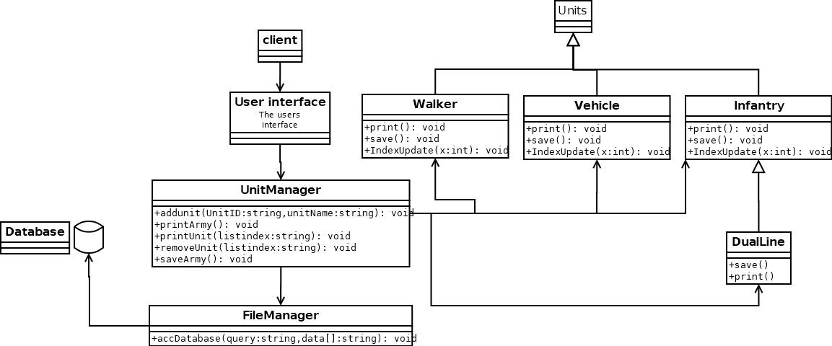
Class Diagrams

Slide 5
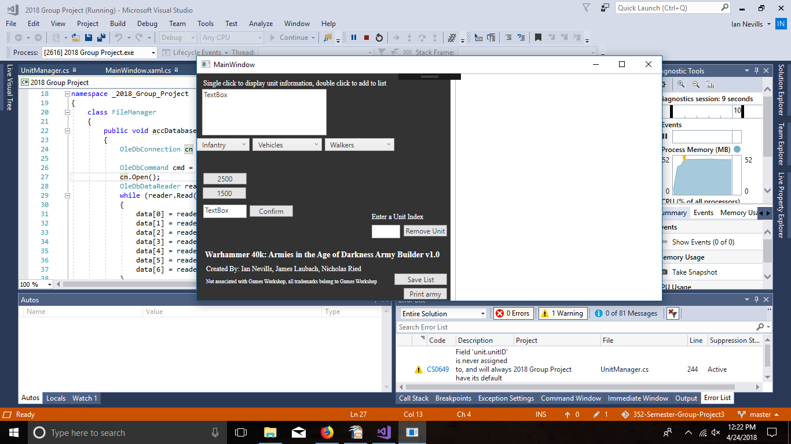
Demo

Slide 6
Future Work
For the future we would like to add the ability to select individual unit upgrades as well as further divide the units into subclasses entailed within the rule book. Another potential future objective would be to allow the user to select an army template, such as those detailed in the book, to build within.

Slide 7
Questions
nicjreid@ut.utm.edu
ianmnevi@ut.utm.edu
jamclaub@ut.utm.edu
OurRepo:
https://github.com/Ian1993/352-Semester-Group-Project

